Slide 1
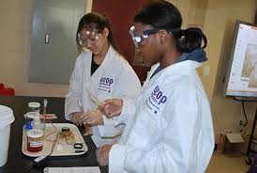
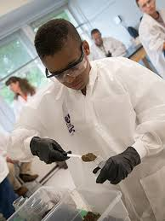
Ready, Set, Research!
Helping Students Get
Comfortable with Research

Slide 2
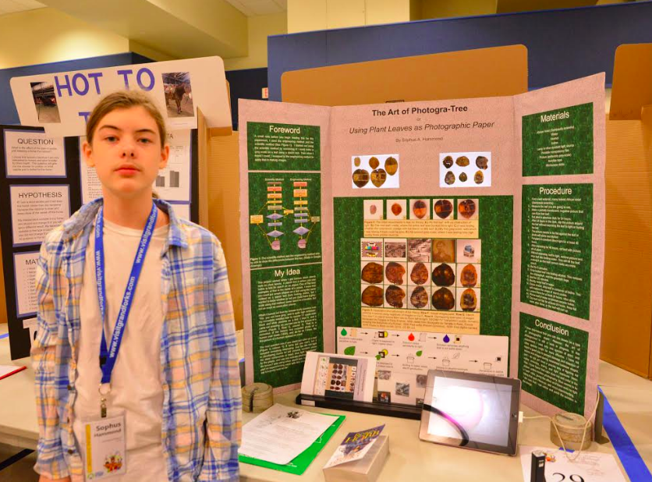
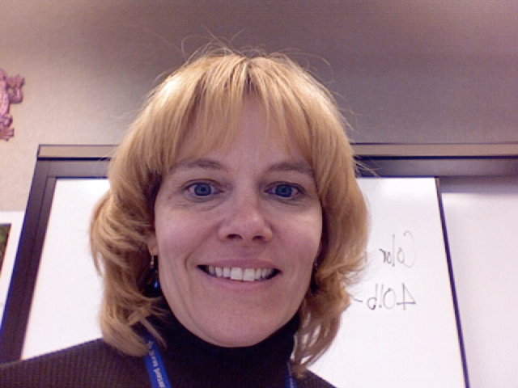
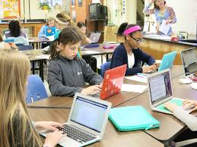
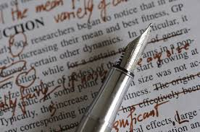
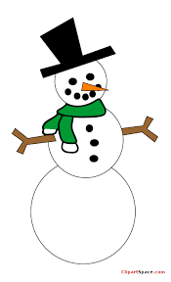
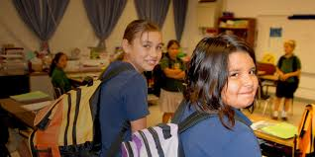
My Science Research Story
9 years ago

Slide 3
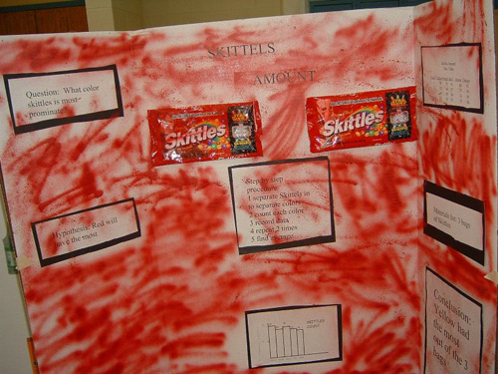
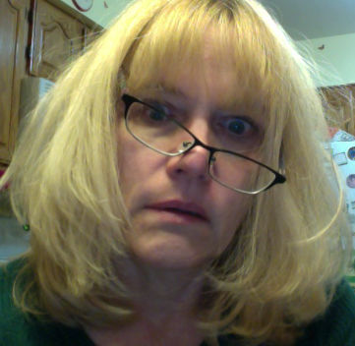
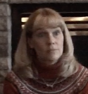
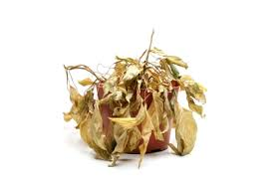
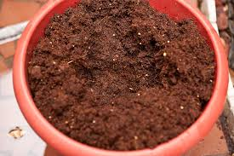
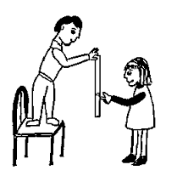
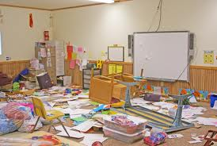
My Science Research Story Continued…

Slide 4
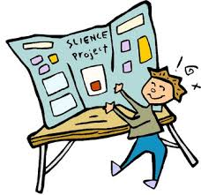
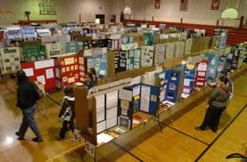
Science Fair Day!

Slide 5
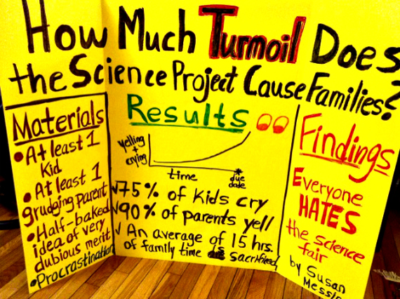

Slide 6
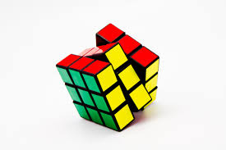
Got Problem Find Solution

Slide 7
Research Checklist
Ideas
Research Ideas
Planning Experiments
Conducting the Experiment
Analyzing Data
Writing Conclusion
Constructing Their Boards

Slide 8
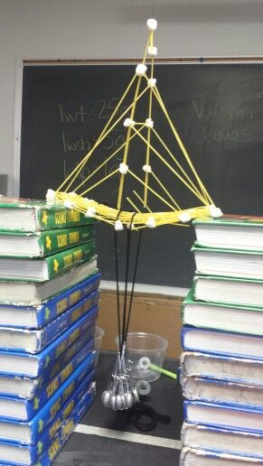
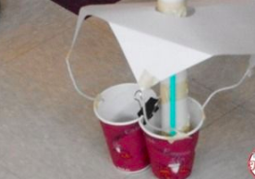
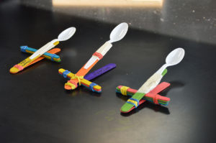
Getting Ready
Start the year with simple STEM Challenges

Slide 9
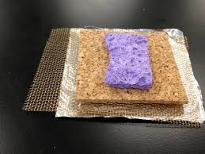
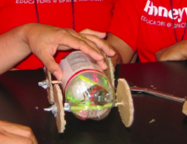
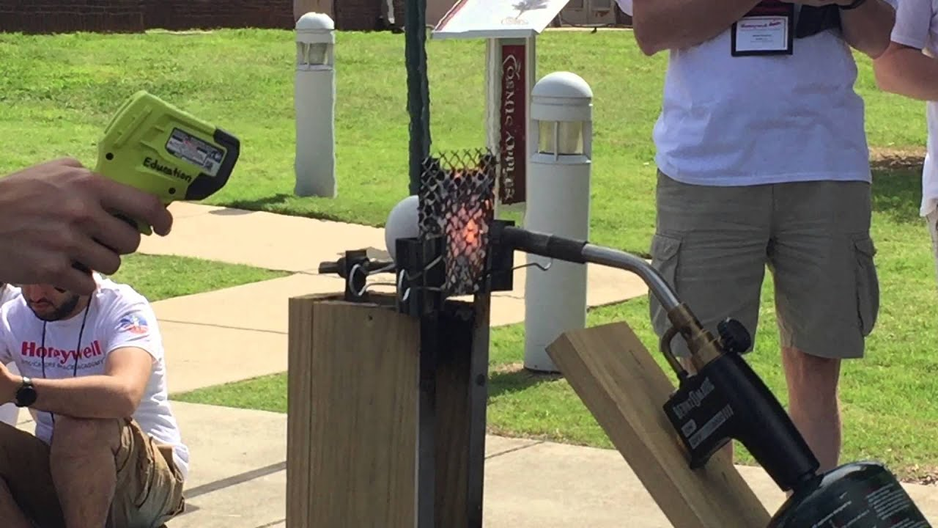
Getting Ready
Next give them a more in-depth Challenge with more Constraints
Notes:
Measurement, constraints, collect data, analyze data

Slide 10
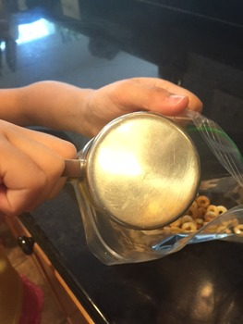
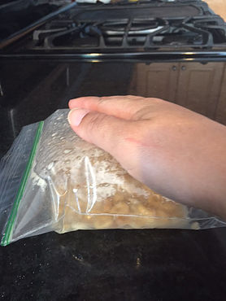
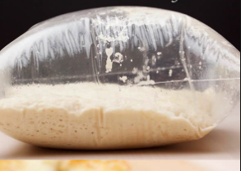
Getting Set
Practicing Science Research as a class

Slide 11
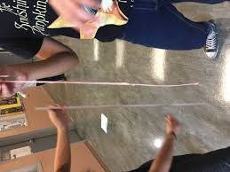
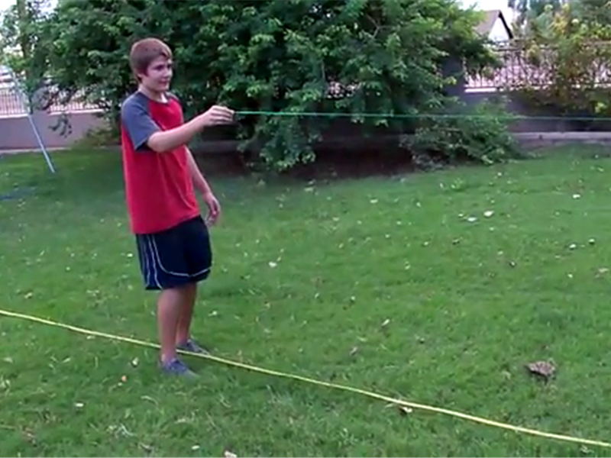
Getting Set
Practicing Science Research as a class

Slide 12
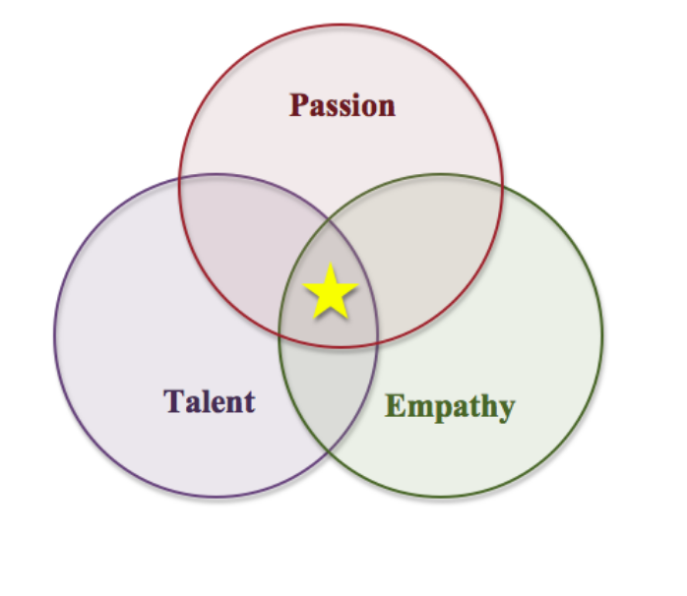
Beginning Research
Brainstorming Ideas

Slide 13
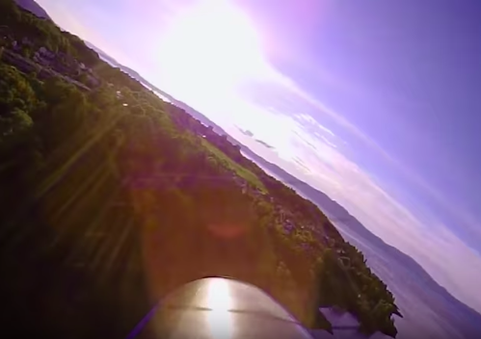
Beginning Research
Brainstorming Ideas

Slide 14
Beginning Research
Brainstorming Ideas

Slide 15
Beginning Research
Finding background information
Writing a short paper
Notes:
5 sources
1st paragraph discuss independent variable, 2nd discuss dependent variable 3 All the possible effects of your independent variable on the dependent variable

Slide 16
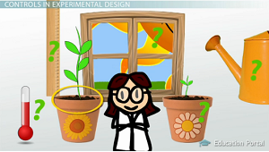
Beginning Research
Designing the experiment
Materials list

Slide 17
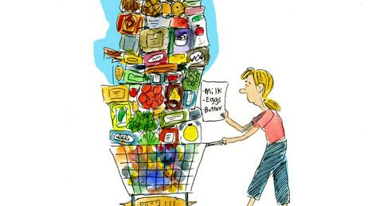
Beginning Research
Purchasing materials

Slide 18
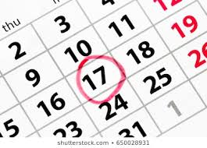
Beginning Research
Choose 3-5 research days in class to conduct experiments

Slide 19
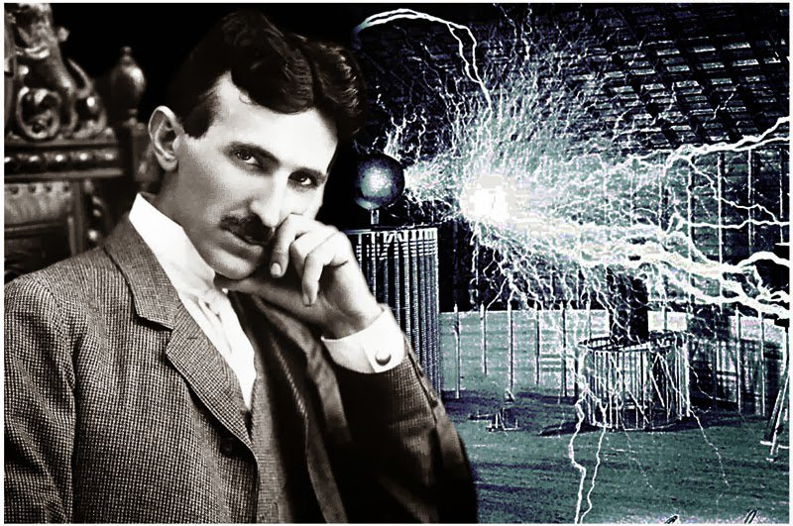
Research!
Curie-osity Hour
Tesla Time
Einstein Hour

Slide 20
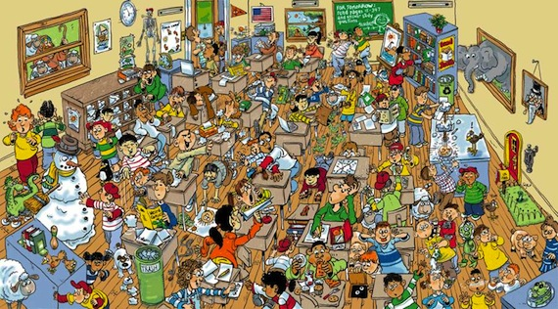
Research!
Frantic
Frazzled
Fascinating
Fun
Fantastic

Slide 21
Research!
Analyze Data
Graph Data
Write a Conclusion

Slide 22
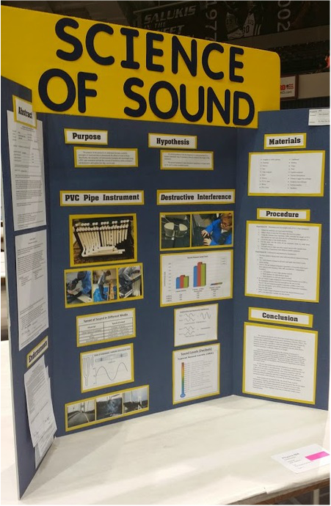
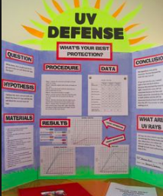
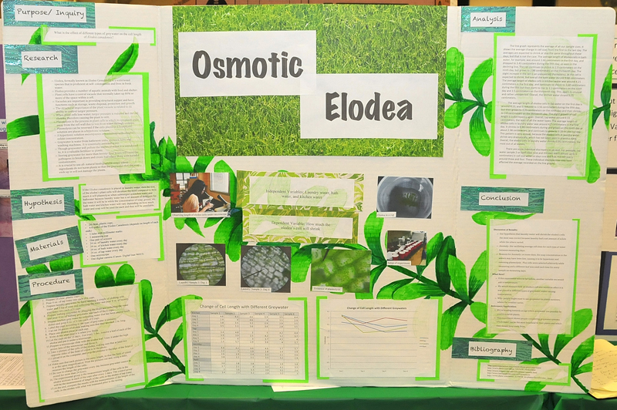
Putting it all together
Science Fair Boards
Practice Presentations

Slide 23
Results
Everyone completed a Science Fair Project
56 Projects
22 projects to the Regional Fair
8 projects went on to the State Fair + both alternates
13 awards at State including 3rd place in the Junior Division

Slide 24
Resources & Questions
Bit.ly: http://bit.ly/RSR2019
Links to online resources for research ideas & stem challenges
Links to some of the activities that I talked about in the presentation
Copy of my online log book
The presentation I give to the students to get them started on their science fair projects

