Slide 1
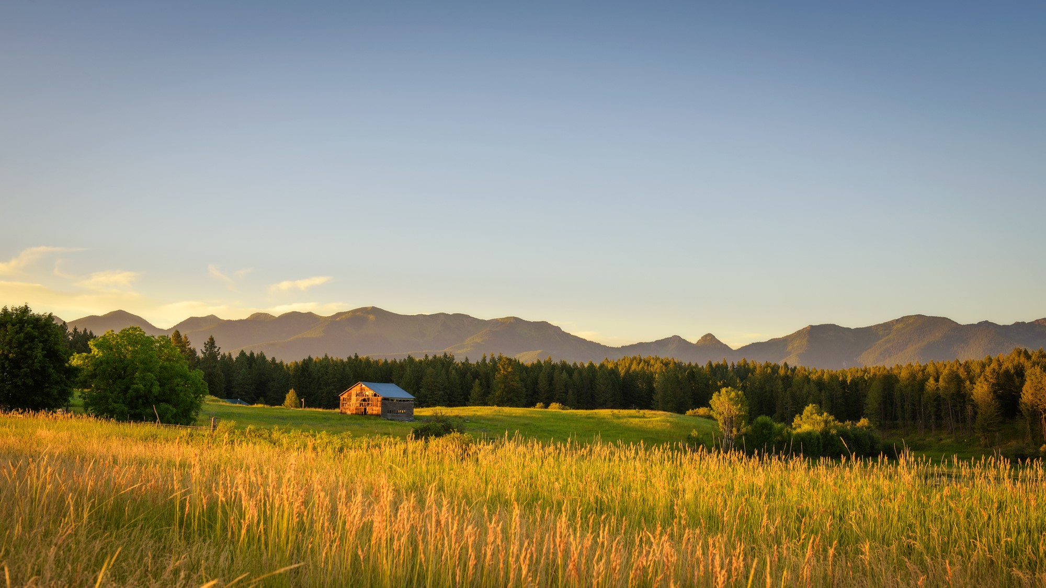
Supporting Student Research in Rural Areas

Slide 2
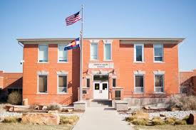
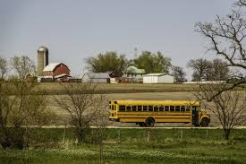
Agenda
Why support students in rural research?
Homegrown Example- Snack with a Scientist
Building Relationships
Gaining Mentorship Support
Finding Mentors
No School is an Island

Slide 3
Why is this important?
International reports and studies commonly find that rural, remote, and regional students underachieve compared to their urban counterparts (2016).
In the USA, rural students have been deemed as disadvantaged in terms of schooling funding and student enrollment in higher education (Schafft and Jackson 2011).

Slide 4
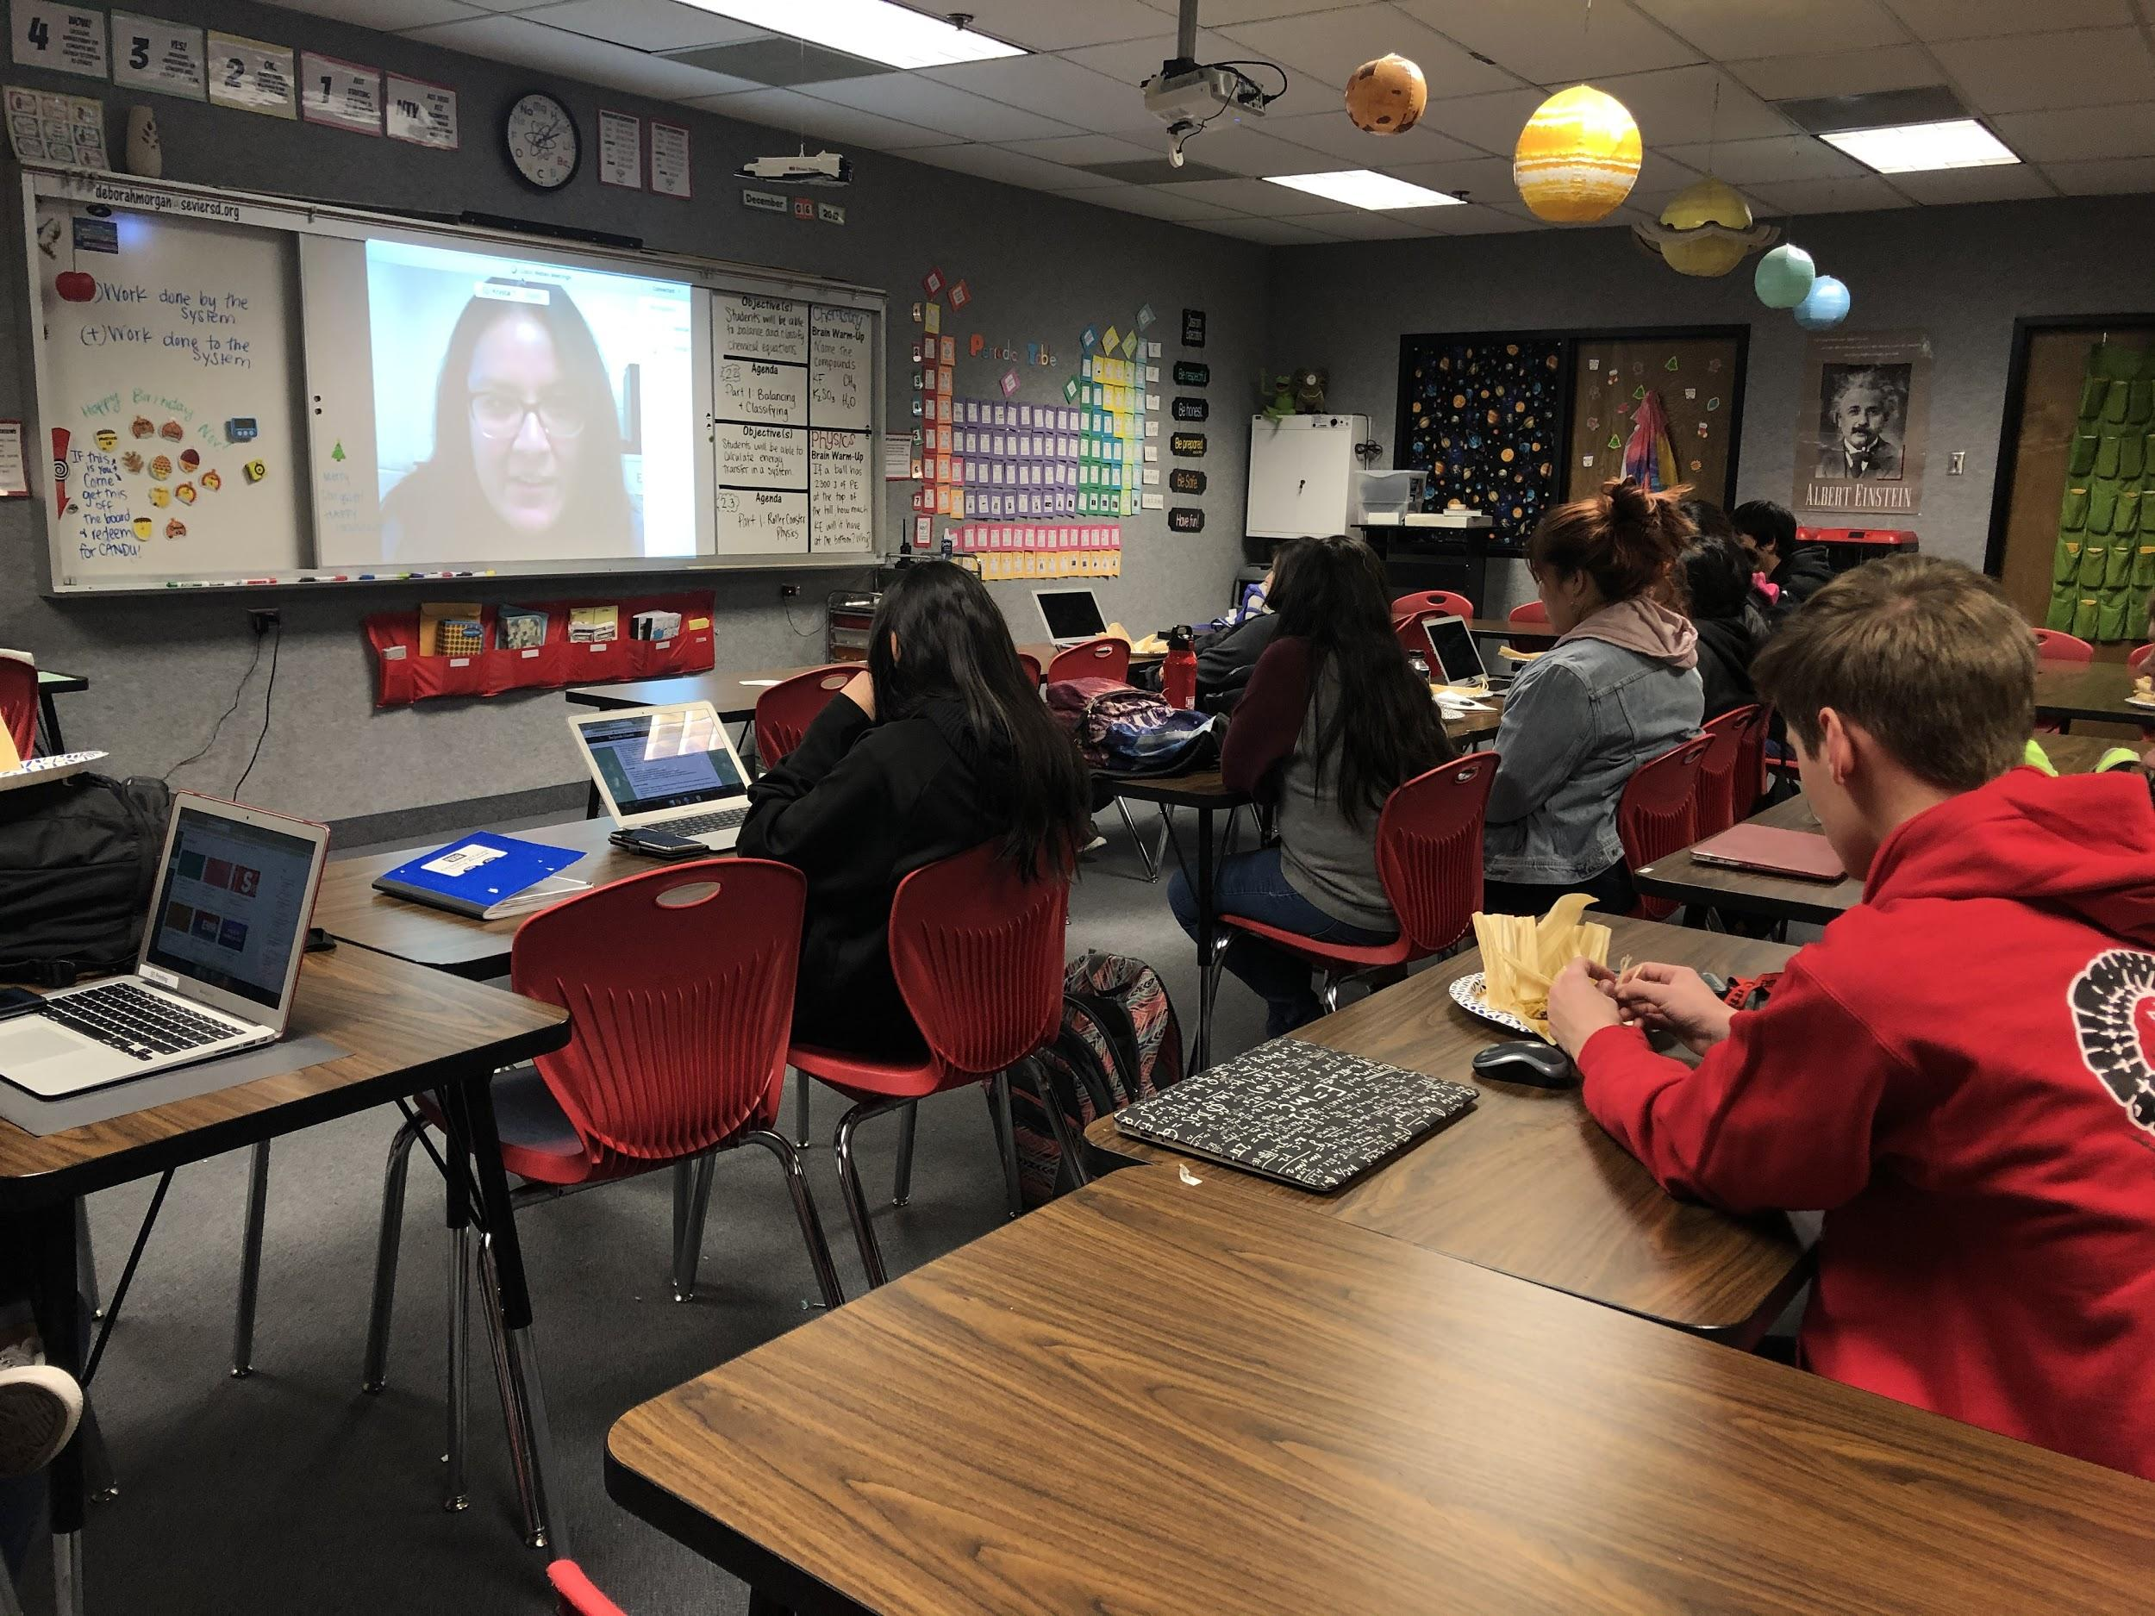
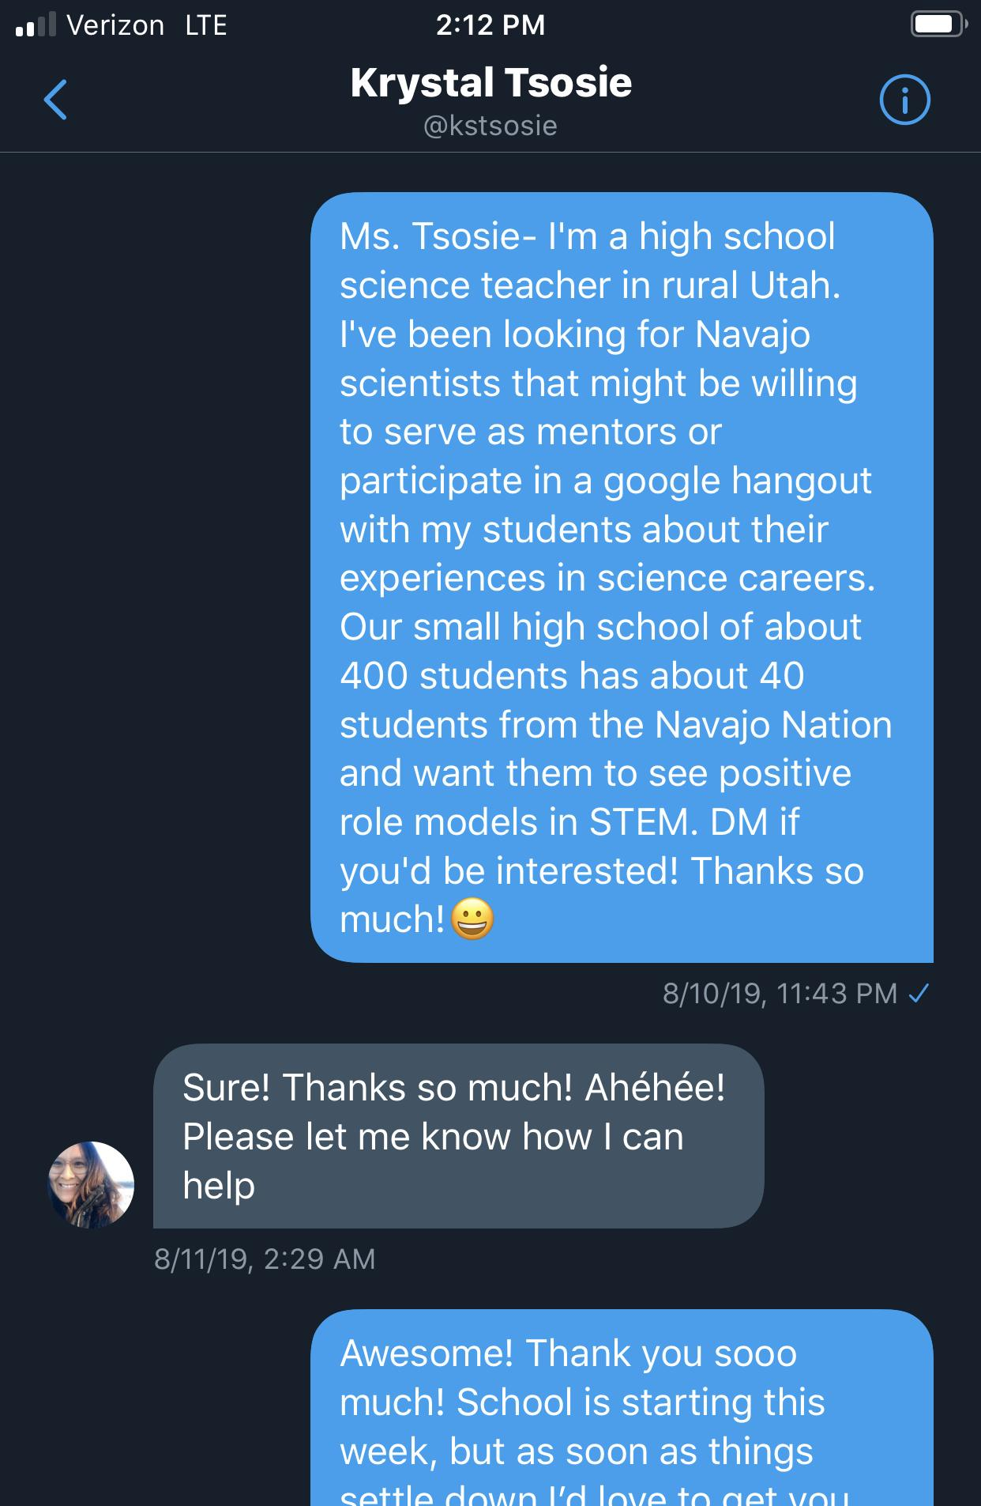
Example- Snack with a Scientist
*gasp* “She looks like us!”

Slide 5
Build Relationships- Invite Them In...
Through webinars, Google Hangouts, Skype, Zoom or FaceTime...
Find connections through:
Twitter or other social media platforms.
Regional and state community colleges/universities, search departments and expertise, send queries.
Parents, colleagues, former students, local community members with scientific backgrounds.
Network at professional conferences.

Slide 6
Ask for Mentorship Support
Have students reach out through email or phone- even social media (through proper channels with supervision!- use teacher email, school twitter).
Use “hard” asks.
Approach the subject matter expert (SME) with a game plan and specific questions.
If that SME isn’t willing or able, ask them for resource suggestions and other SMEs contacts. “If not now, when?” “If not you, who?” “If not this, what?”
Help facilitate what the mentorship will look like: time required, responsibilities, communication etc...
Notes:
Example: Utah State Extension- genetics of pasture grass. Student moved, other student quit, but asked to continue to build a relationship with this scientist.

Slide 7
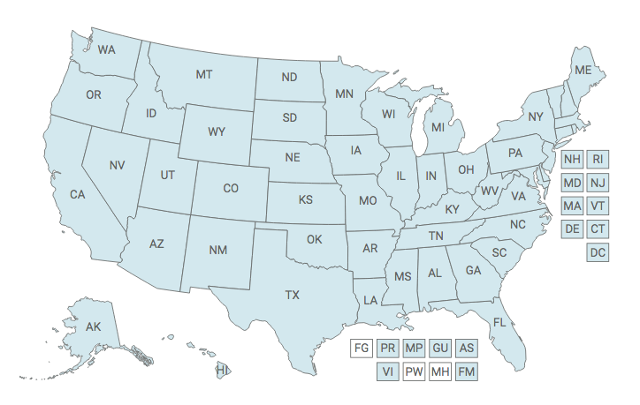
Where to look...
Local extension offices- vast network of scientists, educators, and extension staff that address critical issues about agriculture, food, the environment, and communities.
State colleges and universities- complete listing by state.
Local, State and FUSFS, NPS, DWR, BLM, local, state, and federal agencies.
Notes:
https://nifa.usda.gov/land-grant-colleges-and-universities-partner-website-directory
https://collegestats.org/colleges/all/#

Slide 8
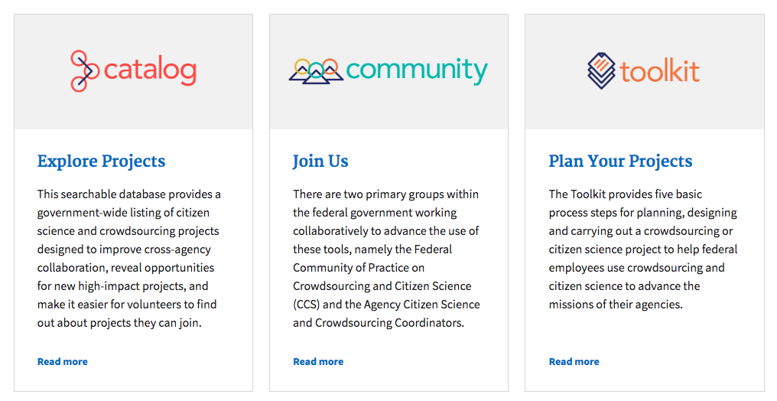
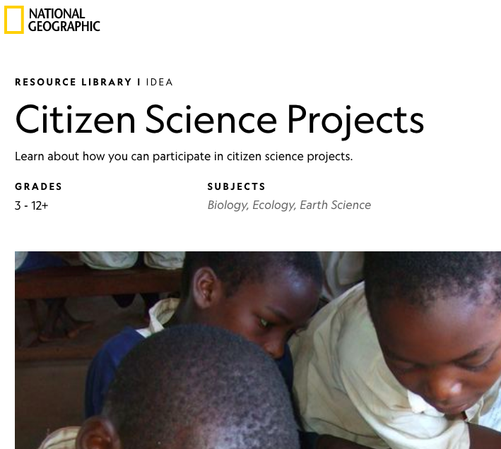
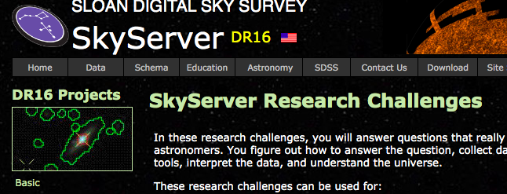
No School is an Island...
Play to your strengths as a scientist. Introduce students to your research background and experiences.
Seek out learning opportunities for yourself and your students with educational programs and citizen science projects:
Federal Government Citizen Science- citizenscience.gov
National Geographic - Citizen Science Projects
Get ideas?- Undergraduate Student Programs- National Science Foundation
Astronomy Programs- NITARP, ExMASS, PSC, SDSS
Notes:
https://nifa.usda.gov/land-grant-colleges-and-universities-partner-website-directory
https://collegestats.org/colleges/all/#

Slide 9
for supporting student research in rural areas!
Thank you

Slide 10
Link to this presentation at:
http://bit.do/sspruralresearch

