Slide 1
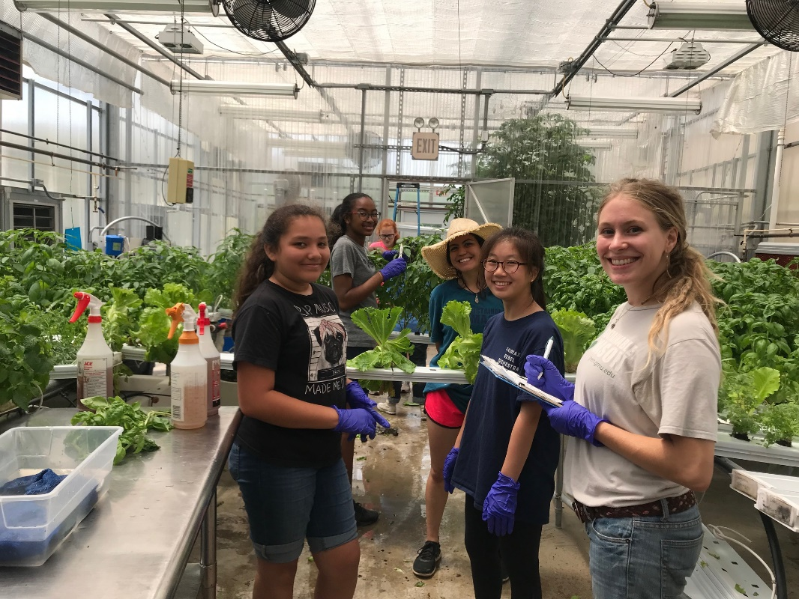
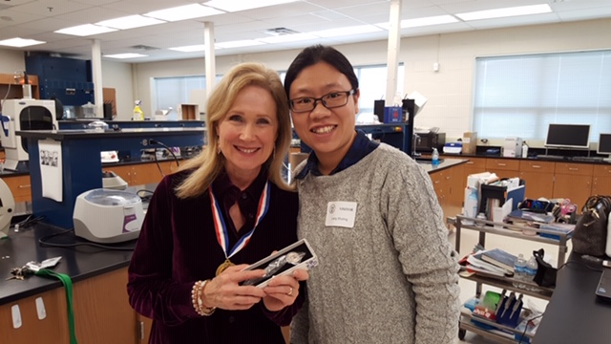
Tips for Applying to Summer STEM (Science, Technology, Engineering and Math) Programs
Presented by Andrea Cobb, Ph.D. (in picture at left)
Director of Student Research and Internships
College of Science
George Mason University,
Fairfax, VA
Notes:
Hello! Today I’m bringing you information about summer stem programs! Some may include the kind of stems in our greenhouse research photo but mainly We are talking about full on research that takes place in many locations throughout the summer! My name is Dr. Cobb and I direct a large summer research program for undergraduates and high school juniors and seniors. I want to share insights from reading a lot of student applications!

Slide 2
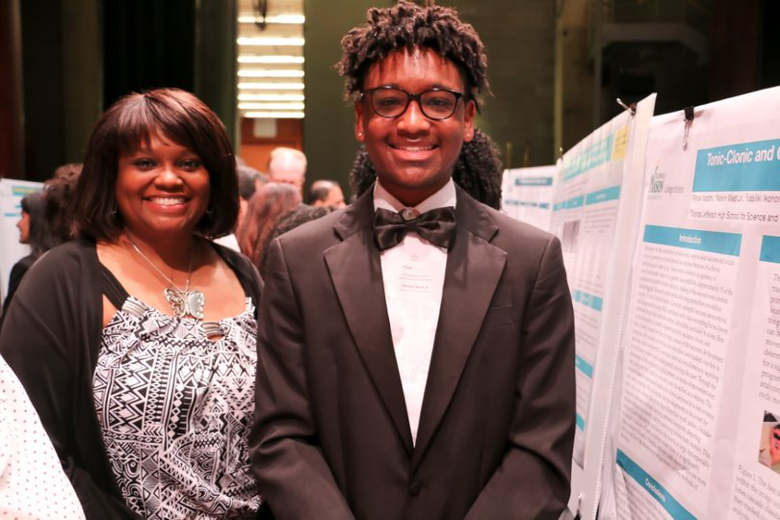
The value of summer STEM research
Participating in a summer lab research program increases:
-your likelihood of acceptance into STEM MD or PhD program (2-4X)
-your STEM persistence and retention in undergraduate programs
-your sense of belonging in STEM student self identity as a scientist, engineer, or mathematician
-your interpersonal and professional skills
-broadens your vision of STEM and professional options
You can use your knowledge to contribute solutions to problems now!
Notes:
So, why would you want to spend most of your summer doing STEM research? Practically speaking, research shows that (see slide). Finally it can be a really creative, interesting and fun experience!

Slide 3
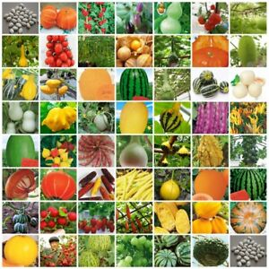
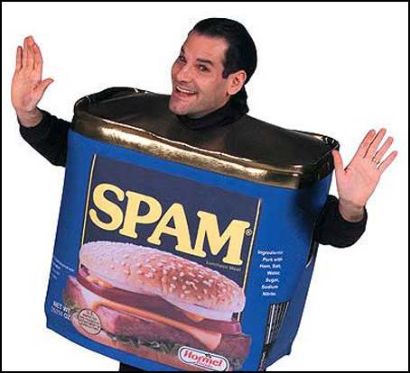
Before you apply-
There are many types of summer STEM/research programs!
Student salaries (stipend)
OR
Is payment required?
Length?
Activities?
Notes:
For most summer research opportunities, your work on an existing project. For funding reasons, it’s very rare that create and implement your own idea from the ground up.

Slide 4
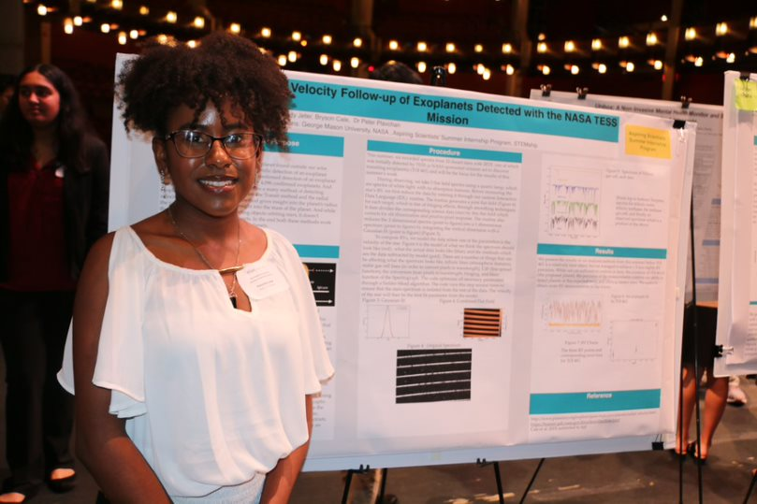
What are you expecting?
Read the program descriptions thoroughly!
Look at links embedded in the program.
Do your expectations match what the program offers?
Visit with several past program participants.
Notes:
Sometimes students do not follow directions. For example, in my program, they will indicate that they want to work with a mentor who is not part of our program because they have not read the directions. We can’t help them!

Slide 5
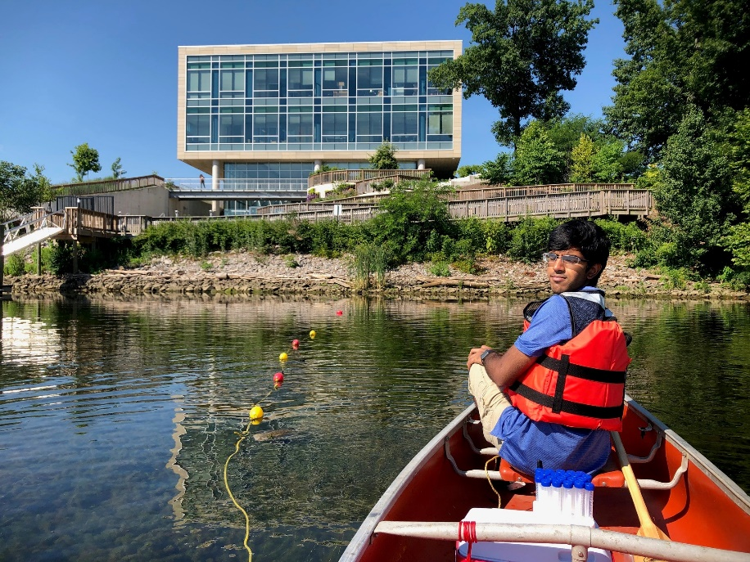
Before you apply-
Does the program schedule match your
availability?
Don’t expect to
-take time away during the program.
-come late or leave early each day.
Transportation?
Housing?

Slide 6
Before you apply-
Do you match admissions requirements?
-Required age, education and experience level?
-Citizenship requirements?
-Certain geographical areas or types of students?

Slide 7
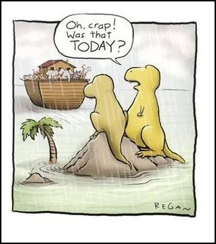
Before you apply-
Check the application deadline!
Submit early to avoid last minute
technical difficulties.

Slide 8
Before you apply-
Will the research experience advance
your career goals?
Does it provide general skills that provide value?
Does it look interesting?

Slide 9
Before you apply-
If possible, download the application and read directions first.
Do you need to:
-Contact possible mentors in advance?
-Provide a record of your grades?
-Provide letters of recommendation?
If so, arrange to get those before
the deadline!

Slide 10
The application:
Use familiar language. Be thorough.
-Include course names (not course numbers)
-Include noncredit coursework and training.

Slide 11
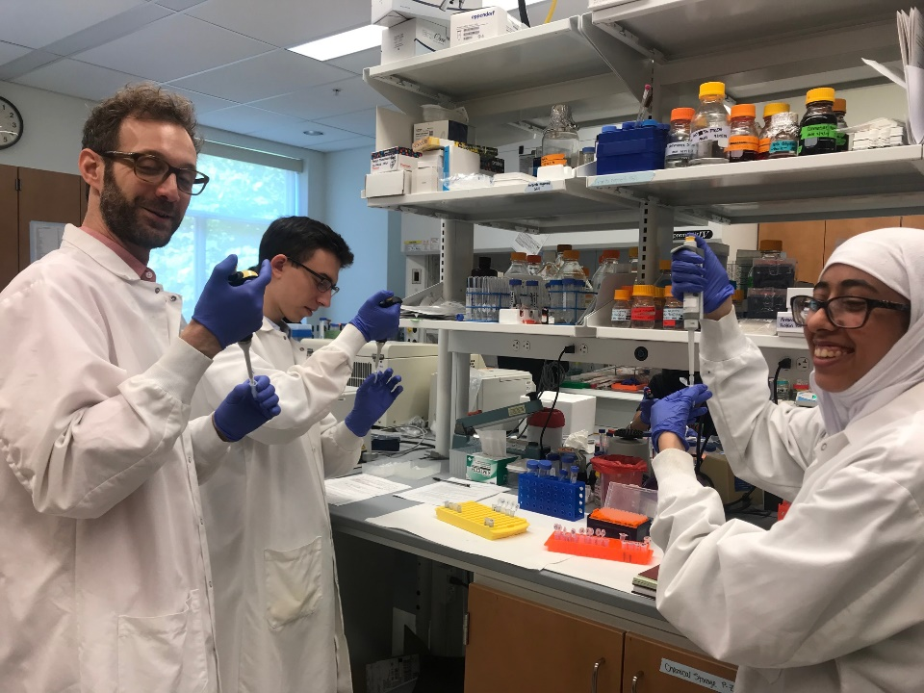
How can you contribute to the program?
What skills, experiences or points of view do you have that will make you a good return on the program’s investment of time, energy and funds?
What specific evidence do you have that you have a history of reliably contributing to a team effort? That you are “low maintenance”?

Slide 12
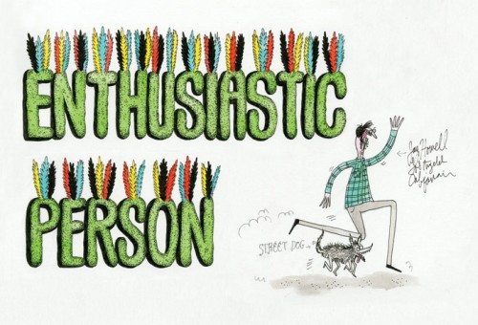
Applications should be…
Enthusiastic!
Positive!
True
Your own work (not mom or dad or their professional buddy)
Grammatically correct
Realistic
Submitted on time
Provide evidence that you are a good match!

Slide 13
Confirm that your submission has been received Practice for a phone, FaceTime or in-person interview!

Slide 14
The hardest part of the application process…..

Slide 15
If you are not matched:
Look for opportunities to grow your own STEM experience
-STEM related service,
-individual research,
-course work,
-read
-travel

Slide 16
If you are selected, look a the link below:
https://www.sciencemag.org/careers/2008/12/making-your-summer-research-internship-good-one
Prepare for a busy and successful summer!

